Slide 1
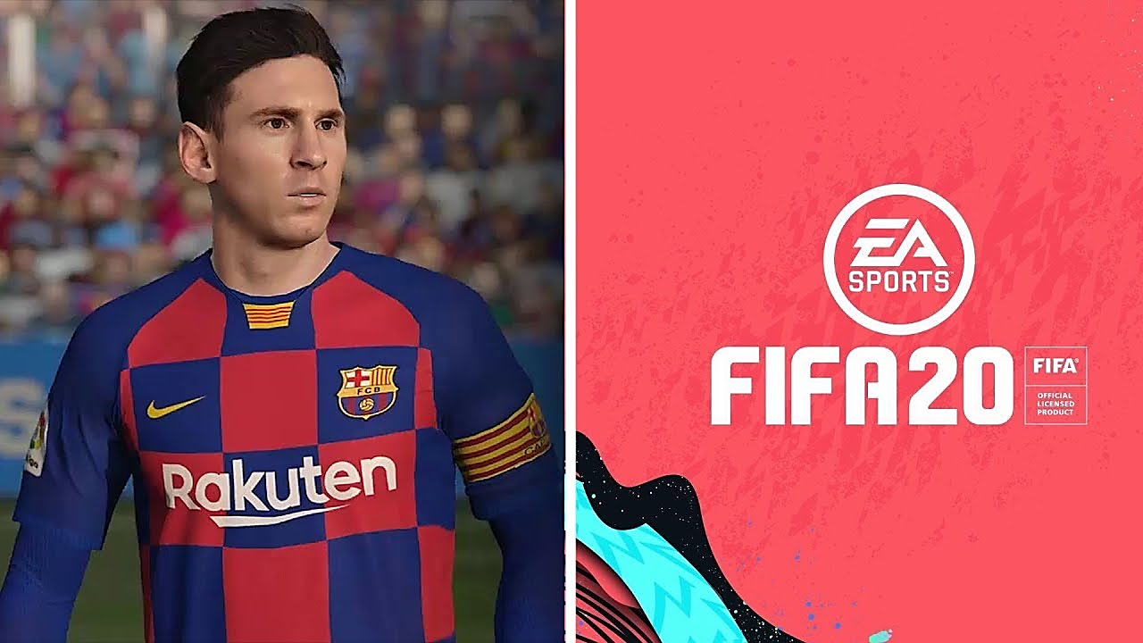
Data mining project

Slide 2


Project Members:
Niv Madmon-312544489
madmon125@gmail.com
Oshri Cohen-313295792
oshrico6@gmail.com

Slide 3
Abstract
In this project, we will analyze the data of FIFA 2020 (football simulation video game).
Our main research goal is:
“what is the relationship between a player’s market value and their rating.”
In addition, we found those topics interesting as well:
“Distribution of player positions and finding the best player in each position according to different conditions”
“Comparison between countries and Distribution of players by countries”
“Comparisons between physical data of all players”
“Which team have the most “top players”?”

Slide 4
Introduction
In our project we will gather, process and evaluate Fifa2020 data.
We divided the project into three main parts
Data Acquisition:
Scraping the FIFA2020 players from Futwiz site. (https://www.futwiz.com/en/)
Data Cleaning:
Arranging and cleaning the information and fill missing data.
Data Evaluation: Different plots for a visual representation of the data. SKLearn Machine learning for attributes predicting accuracy analyzing (linear regression) .

Slide 5
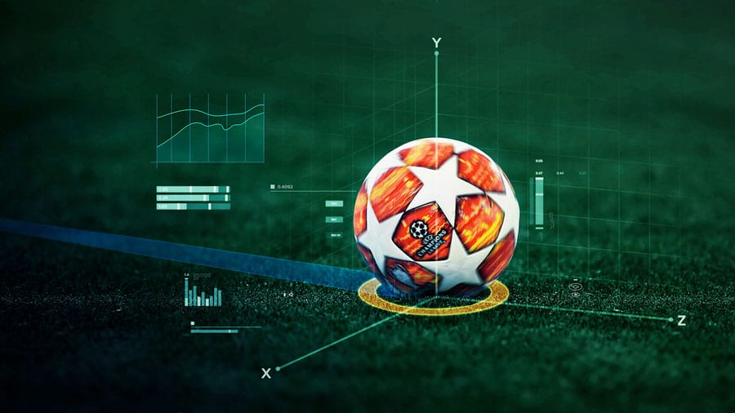
DATA
ACQUISITION
After we have chosen a subject for data mining project, we started researching the best source of data.
Our requirements were to get as much data as possible about FIFA 2020 football players, the data needs to be reliable and up to date.
Finally after comparisons we decided scraping FIFA 2020 data from ‘futwiz’ site by scraper.

Slide 6
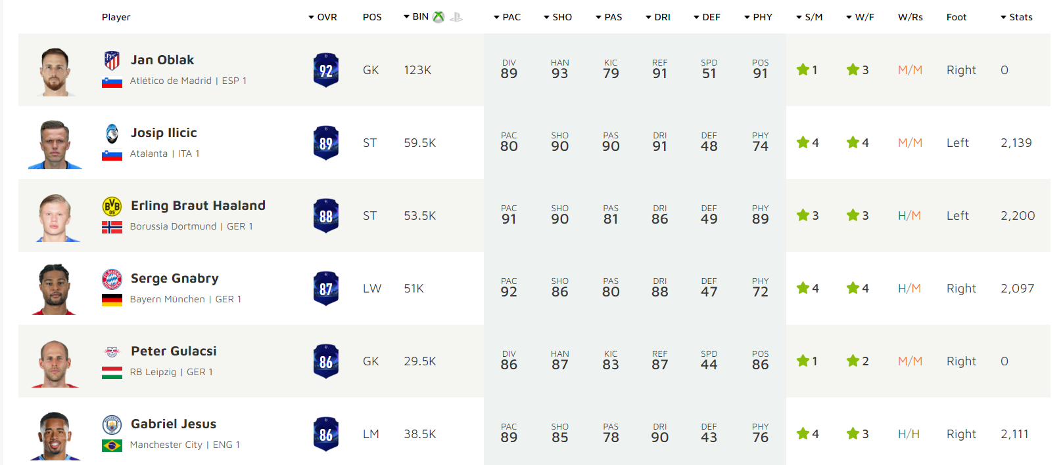
SCRAPING FIFA20 DATA FROM FUTWIZ
Scraping the FIFA2020 players from Futwiz by beautifulsoup and request.
Creating a table which contains each player his total parameters.
Each player have : Name, Club, Nation, Age, Height, Weight, Foot, Wage, Value, Position,Rating,Potential.
And personal abilities: Acceleration, Sprint Speed, Positioning, Finishing, Long Shots, Penalties, Shot Power,Volleys, Crossing, Curve, FK. Accuracy, Long Pass, Short Pass,Vision, Agility,Balance, Ball Control,Dribbling, Reactions, Composure, Heading Acc,Interceptions, Marking, Stand Tackle, Slide Tackle, Aggression, Jumping, Stamina, Strength.

Slide 7
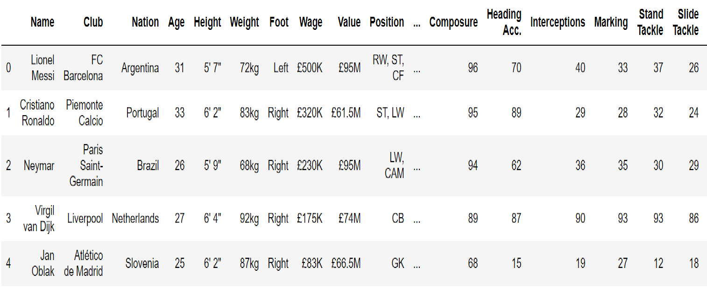
DATABASE STRUCTURE
Our database include :17895 rows and 41 columns, that include information about all the players in Fifa 2020.
The data frame that we created is numbered by index according to the player's ratings. As you can see in the table Lional Messi have the highest rating on Fifa 2020.

Slide 8
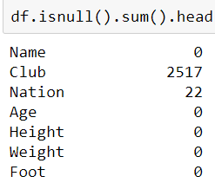
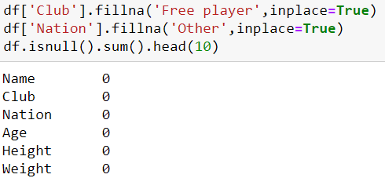
Data cleaning
Now that we have the data as presented on futwiz website, We need to clean and process the data so it will be available for our analysis.
First of all we searched for null values fill missing values.
We found out that there are 2517 players with no club so we change their Club value to “free player”. we also found out that there are 22 players with no nation so we change their Nation value to “other”.
Now, as we can see in picture, there are no more null values in our data frame.

Slide 9
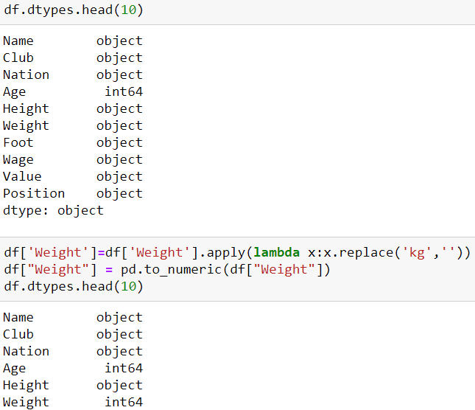
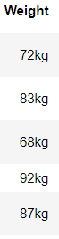
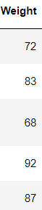
Data cleaning
We wanted to convert the weight column from “object” type to “int” type so we can analyze it and use the values in this column.

Slide 10
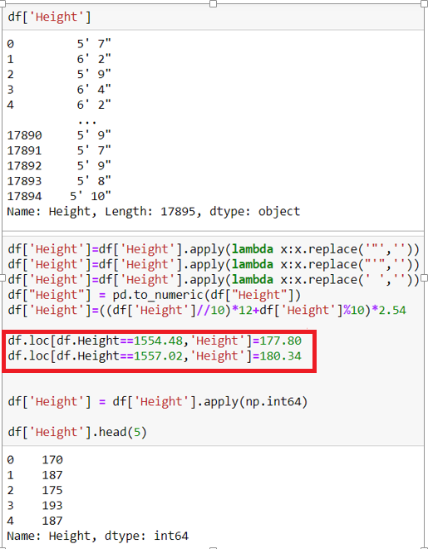
Data cleaning
We also want to convert the Height column from “object” type to “int” type, so we can analyze it and use the values in this column.
We used formula to convert Foot size to Centimeters size.
Our formula worked great except two problematic cases the players that are 5’ 10” tall and 5’ 11” tall.
So we changed their values ​​separately.

Slide 11
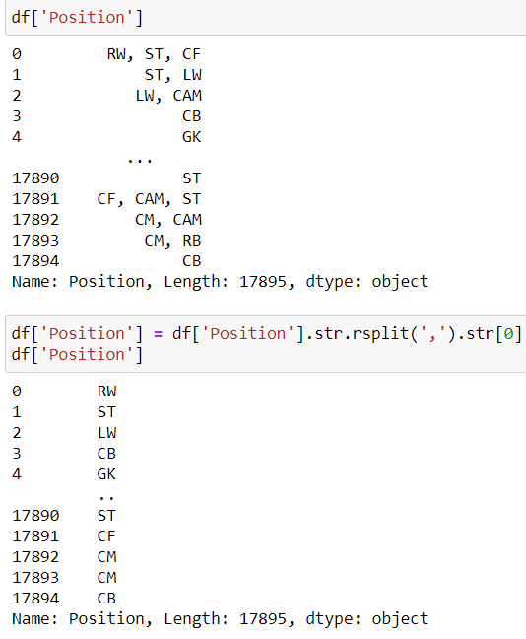
Data cleaning
In the position column we got some values ​​for each player, there are players who can play in several positions.
The first position is the natural position of the players and the best positioning for them to play in the game.
So we took the main positions of the players for our analyze.

Slide 12
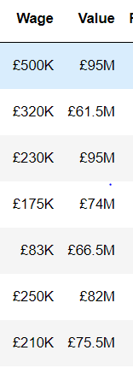
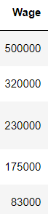
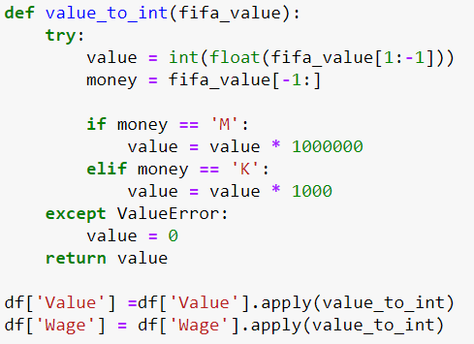
Data cleaning
We also converted the variables of wage and value from “object” type to int “type”, so we can analyze it and use the values in there columns.

Slide 13
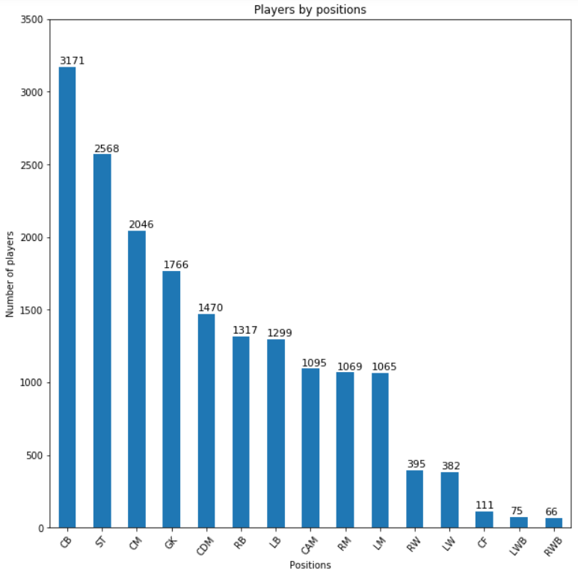
EDA
Positions
We presented the distribution across positions. We can see that the most common position of the players are central back (CB).
We can also see that striker(ST) and central midfielder(CM) are also widespread positions.
We found out that the fewest positions of players are the offensive defenders (LWB,RWB), It can be seen that these positions are much less common.

Slide 14
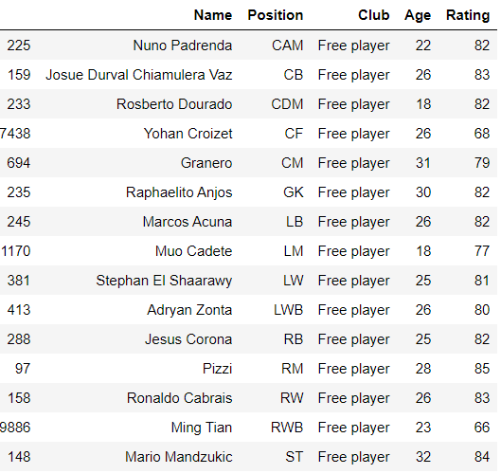
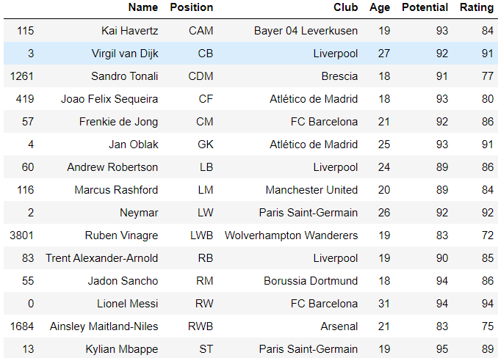
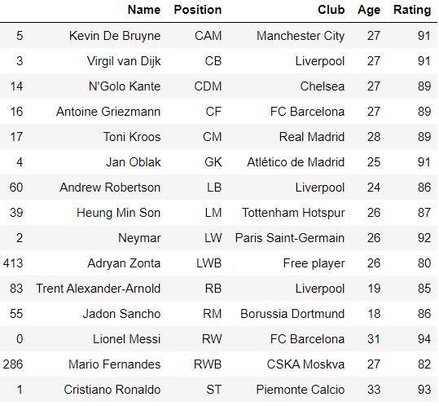
EDA Positions
(1)-In this table we have presented the best player for each position in the Fifa 2020 game, we can see that the players in all of the position except rwb\lwb are in top 90 players and have above 85 rating .
(2)-In this table we have presented for each position the player whose potential rating is the highest. It can be seen that the average age(21.6) in this table is much younger than the previous table(26).
We also found out that Sandro Tonali is extremely talented, although he is just in place 1262 in the game, he has the potential to be the best CDM in the game.
(3)-In this table we have presented the best free player (without a club) for each position. We found out that there is player in this list than contain to top 100 players in the game (Pizzi)
(3)
(2)
(1)

Slide 15
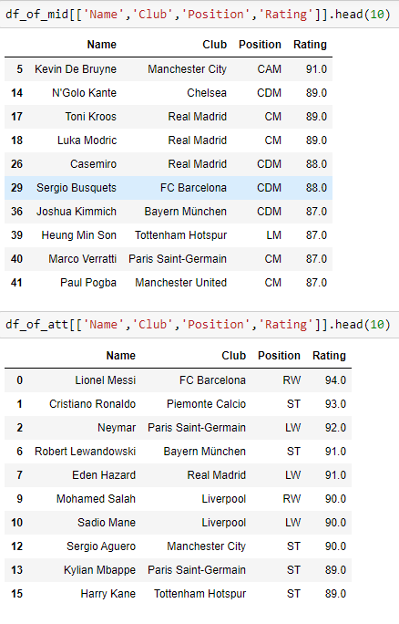
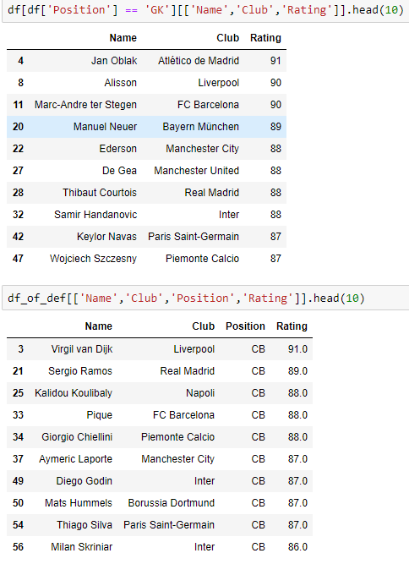
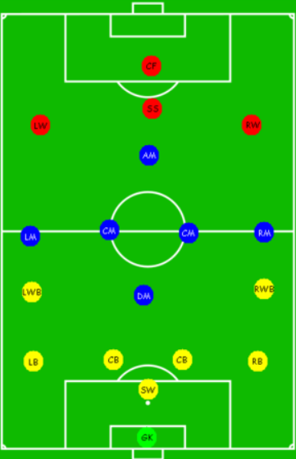
EDA Positions
We divided all the players into 4 new tables: goalkeeper (green) , defense players (yellow) , midfielder players (blue) and offense players (red).
We presented the top 10 for each table.
We found out that all the top
10 of defense players table are in the
Same position (CB).
We also found out that 10 of the
The top 16 players in the game are
Offense players.

Slide 16
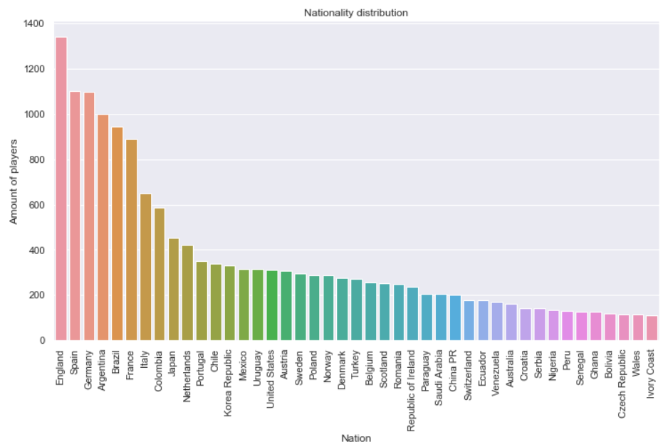
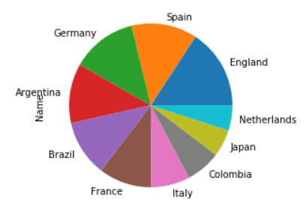
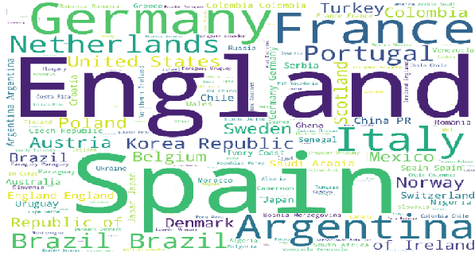
EDA Nationality
We presented the distribution across countries, we have also shown the most common (top 10) nationality by pie diagram.
We can see that England have the most players in the game.
We can also easily see that most of the players in the game are from Europe (6 from top 10 nation come from Europe) and after that there is many players from South America (Brazil, Argentina and Colombia)
We surprisingly discovered that there is many players in the game that come from japan.

Slide 17
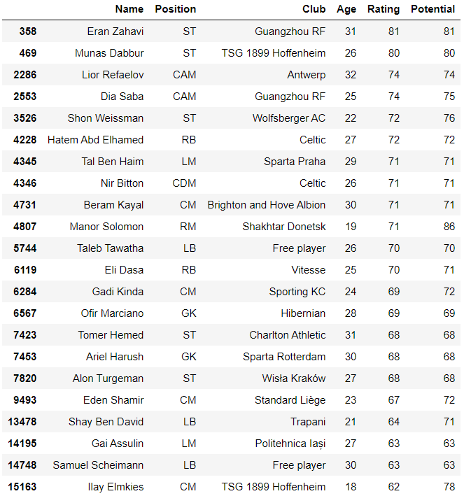
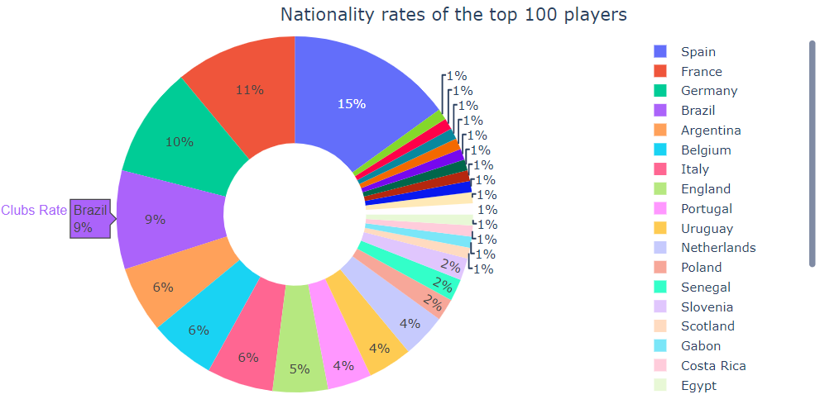
EDA Nationality
We have found out the nationality rates of the top 100 players in the game (by percentage) , we have also found out all the Israeli players in the game.
We not surprised to find out that there is no Israeli players in the top 100.
We found out that there is 22 Israeli players in the game and except 2 players (Eran Zahavi and Munas Dabbur) the Israeli players are pretty average and not so good.
We also found out that Manor Solomon is amazing talent and have potential to be great player.

Slide 18
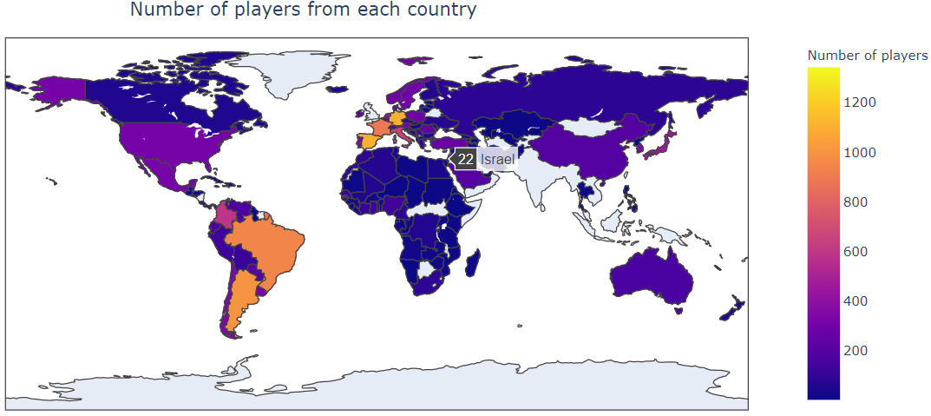
EDA Nationality
By using plotly we create choropleth maps. A choropleth map is a map composed of colored polygons.
Now we can see by the color of the country how many players they have, we can also click with the mouse on the countries and see exactly how many players they have in the game (as we can see in the picture here that Israel have 22 players).
We also can verify here what we see earlier that most of the players in the game come from Europe and South America.

Slide 19
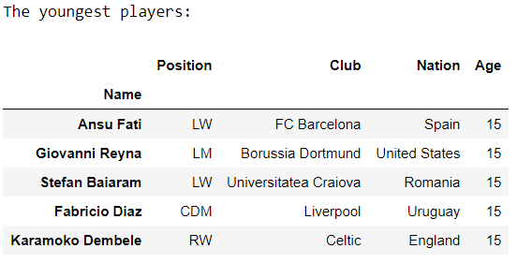
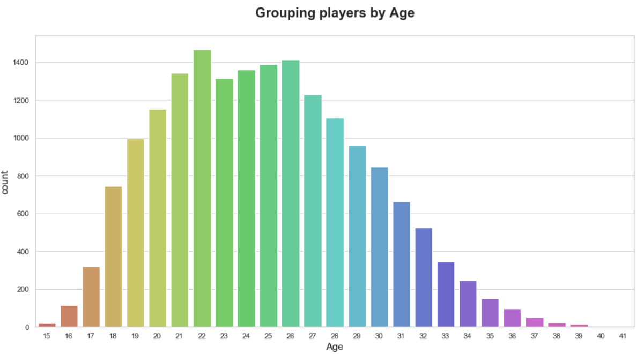
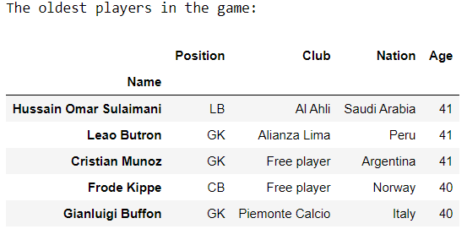
EDA Physical
First of all we explored the age’s players in the game.
We found out that 22 years old is the most common age in the game. We also found out that ages between 21 to 26 is very common ages and ages 15 and 38-41 is very rare in this game.
We also found out who are the youngest players in the game- a small number of 15 years old.
And who are the oldest players in the game- 3 players of 41 years old and 6 players of 40 years old.

Slide 20
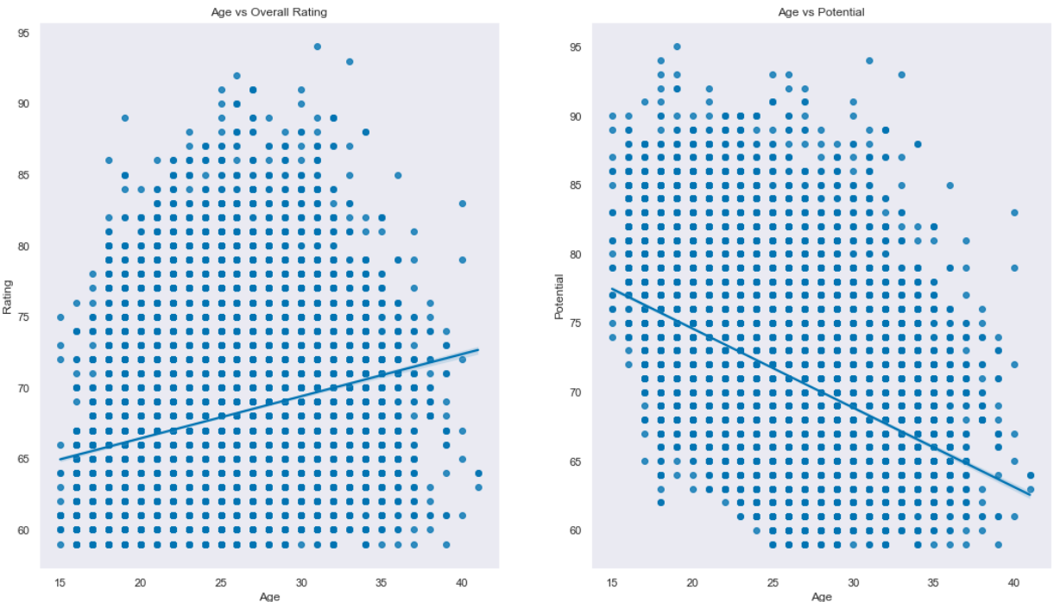
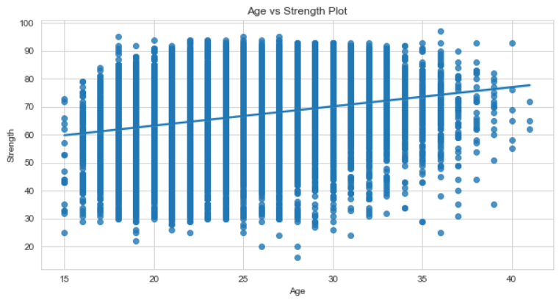
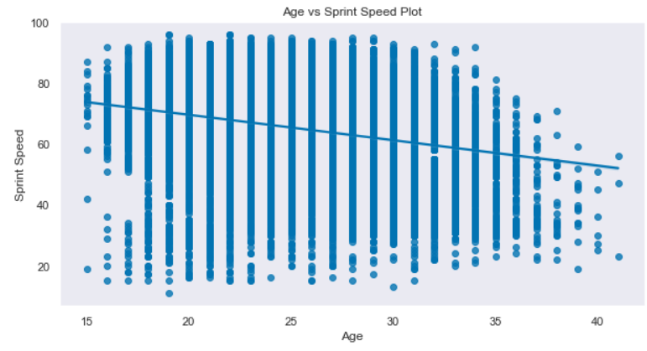
EDA Physical
We wanted to see how age influencing on the rating and potential of the players. We found out that average rating increase as the age of the players increase. From the other side the average potential decrease as the age of players increase.
We also checked how age influencing on some Physical abilities. We found out that when players become older in the game the improve their strength ability, from the other side- when players become older their speed ability decrease.

Slide 21
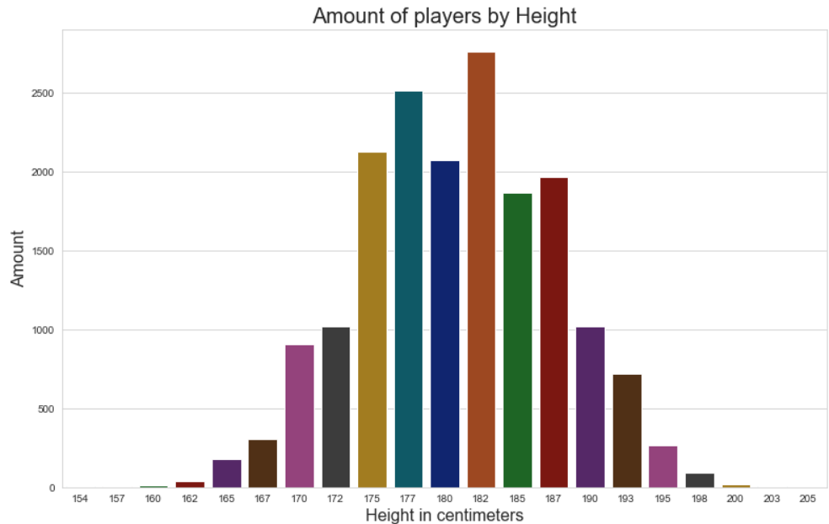
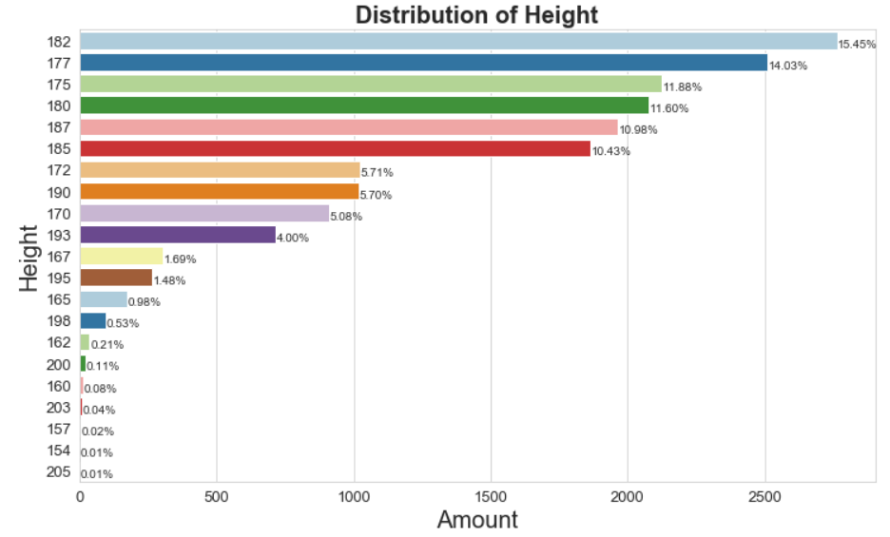
EDA Physical
The next thing that we explored is the height of the players.
We found out that the most common of height in this game is 182 and 177 also very common. Players with height of over 200 centimeters or under 160 centimeters are very rare to find in this game.
We also found out that the tallest player in the game is 205 centimeters tall and the shortest player is 154 centimeters tall.

Slide 22
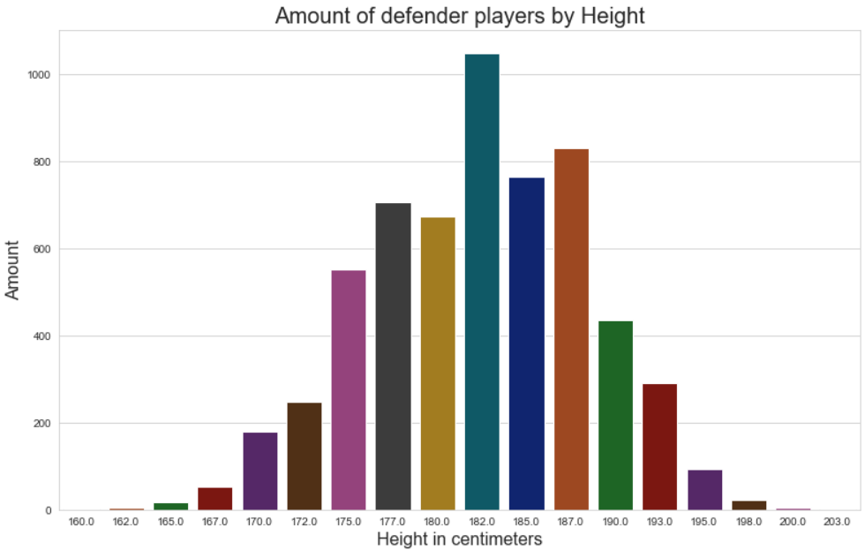
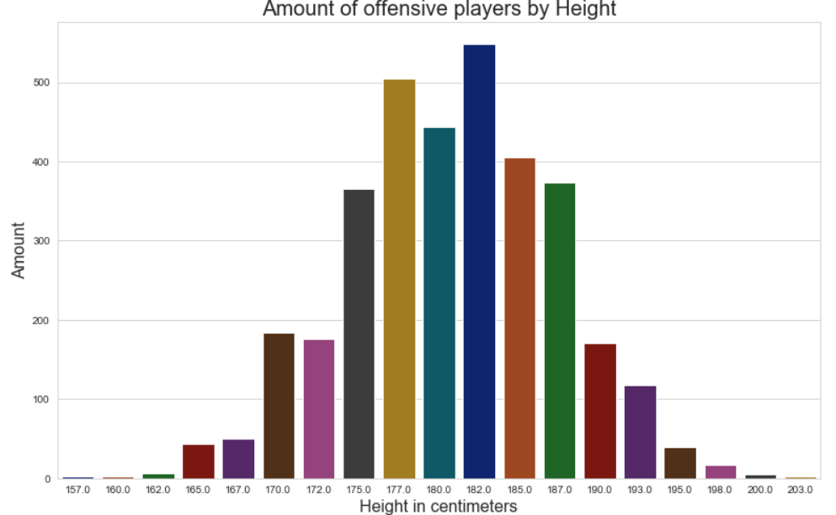
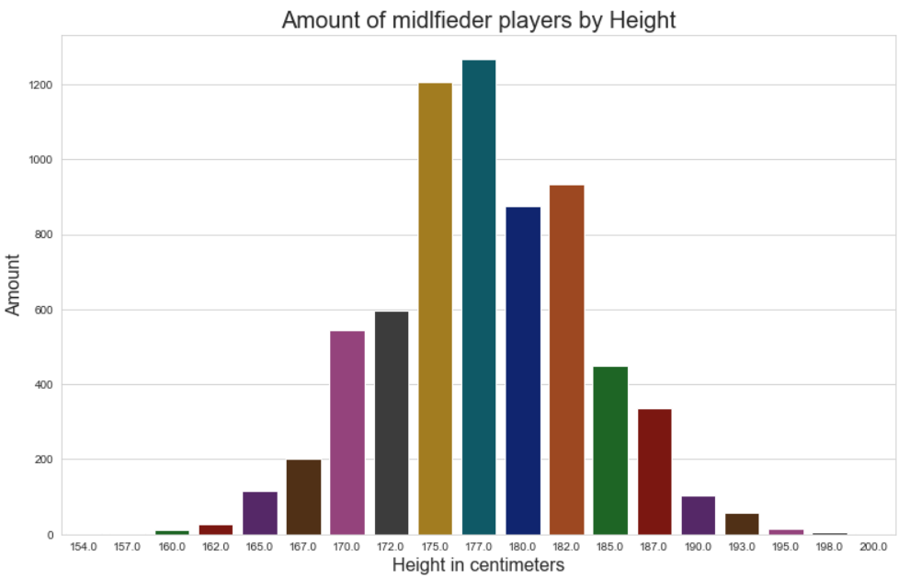
EDA Physical
We also explored the height of the players by categories of their positions (defend, midfielder and offensive players- by using the groups that we created earlier in the eda of positions).
We found out that the 3 height most common of defend positions are 182, 187 and 185.
In the midfielder positions there are 177, 175 and 182.
And in the offensive positions there are 182, 177 and 180.
We can see that the common height of defend positions is higher than the other categories of positions and that the common height of midfielder
positions is lower than the other categories of positions.
We also see that 182 is common height in all of the categories.

Slide 23
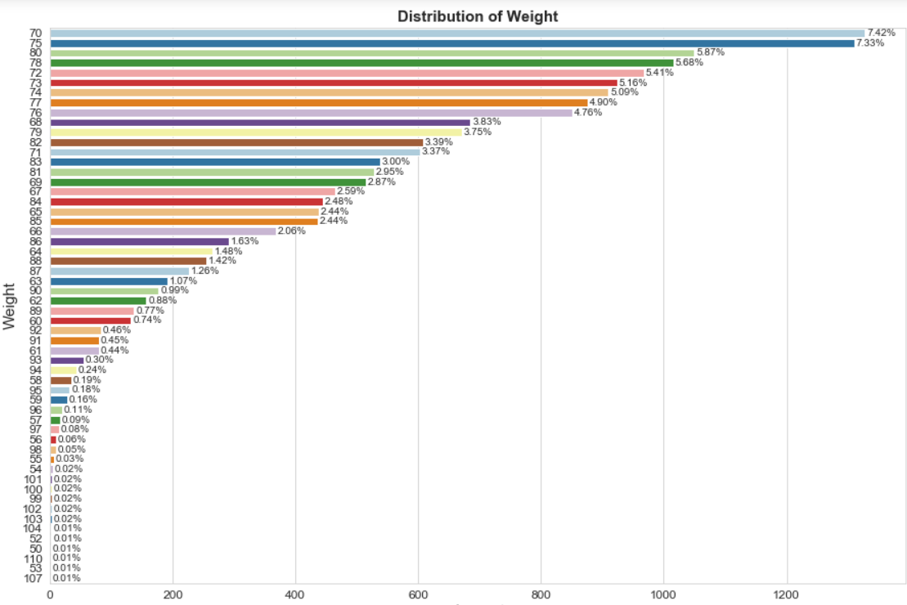
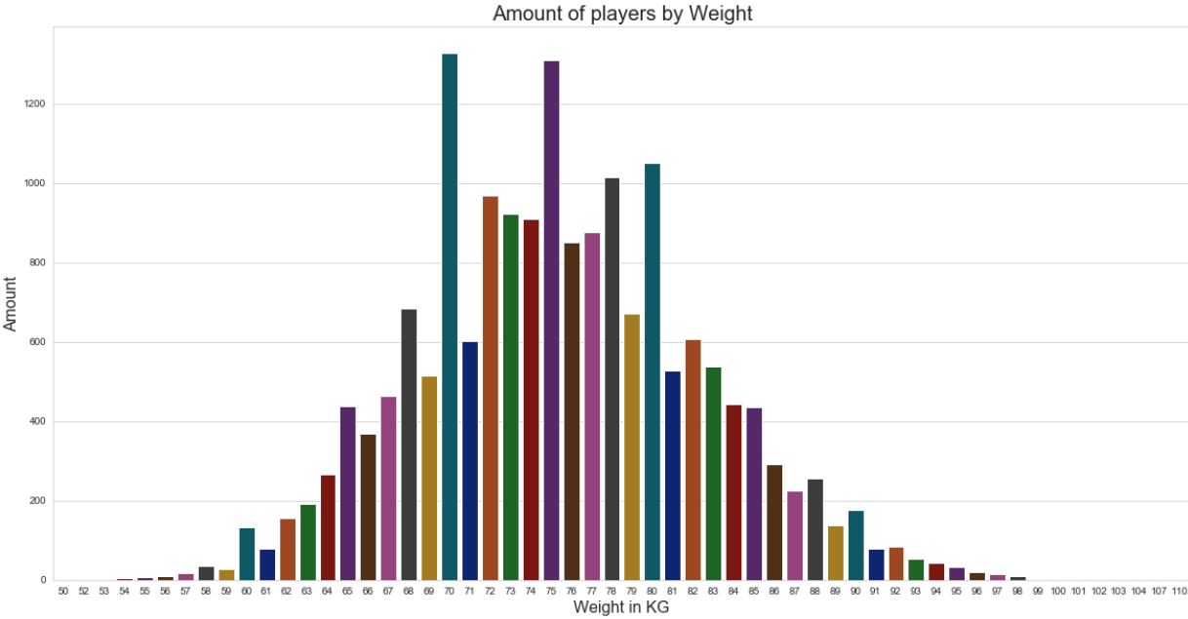
EDA Physical
The next thing that we explored is the weight of the players.
We found out that 70 and 75 kg is the most common weights of players in the game. Players with weight of over 98 kg or under 54 kg is very rare to find in this game.
We also found out that the player who weighs the most has a weight of 110 kg and the player who weighs the least has a weight of 50 kg.

Slide 24
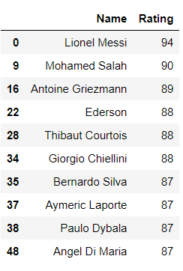
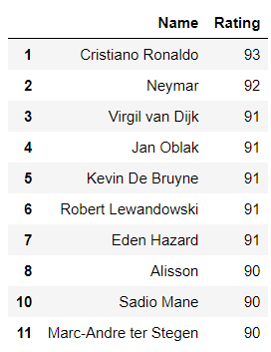
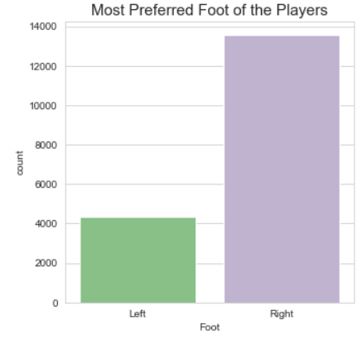
EDA Physical
The last thing of physical qualities that we that we checked is the prefer foot of the players in the game.
We found out that there are far more right footed players than left footed players.
We also checked the top 10 players for each foot, we can see that also with the top players there are far more right footed players and 39 from top 49 players in the game are right footed.

Slide 25
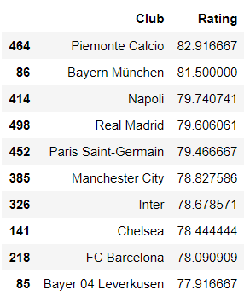
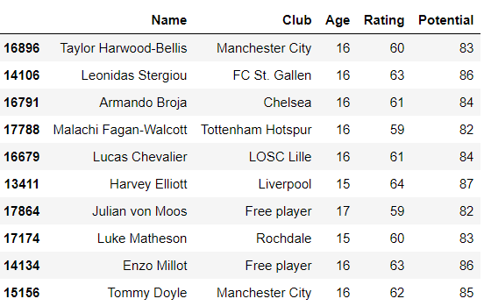
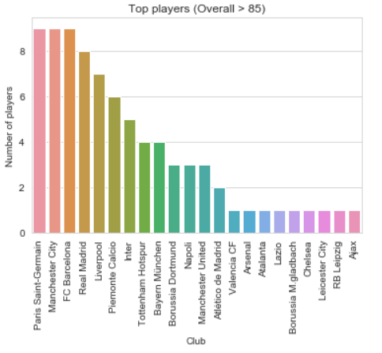
EDA top players and teams
In the first data (1) we checked which are the top 10 teams in the game that have the most average rating of players.
We found out that Piemonte Calcio (Juventus) and Bayern Munich have players that their average raring are more than 80.
In the second data (2) we checked which teams have the most 85+ rating players (top players). We found out that although Juventus are the top team in data (1), they are just in 6th rank of the top players list.
In the third data (3) we checked which are the most talented players in the game, which players can get the most improvement in the game. As we thought, we found out that all the players in the list are very young and just one player of them older than 16 years old. We also find that all the players in this list have the same room to improve, each one of them can improve his rating by 23.
(3)
(2)
(1)

Slide 26
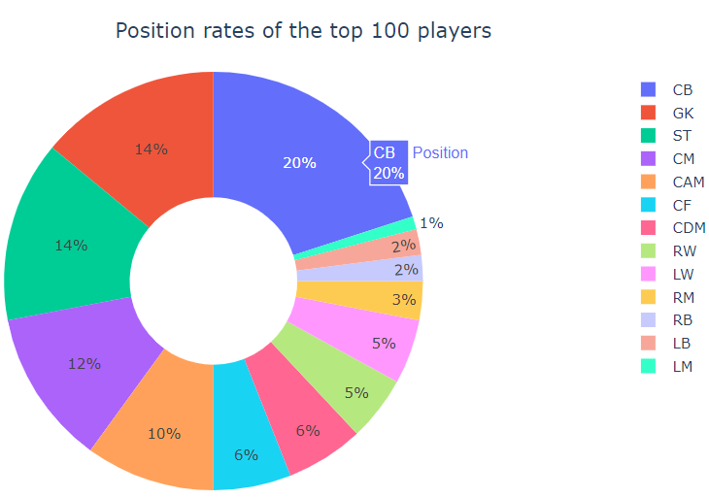
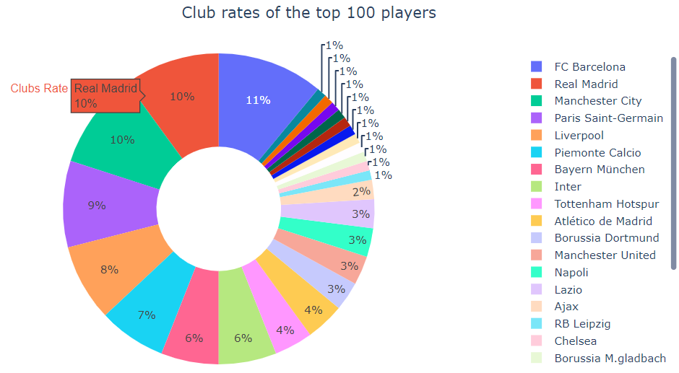
EDA top players and teams
The last thing that we explored is the top 100 players by positions and clubs.
We found out that there are no LWB or RWB players in the top 100.
We can also see that Central Back (CB) is the most common position among top 100 players of the game. Immediately after that appears goal-keeper (GK) and Striker (ST). We can also see that there is just 1 Left Midfielder (LM) in the top 100.
We found out that Barcelona have the most players in the list of the top 100, they have 11 players in the list, a little before Real Madrid and Manchester City that have 10 players in the list.
We also see that the top 100 players come from 26 different clubs.

Slide 27

Machine Learning
Since it is reasonable to think that there could be a linear relationship between a player’s market value and how good they are(rating).
Then we can create model applying linear regression.
We used scikit learn.

Slide 28
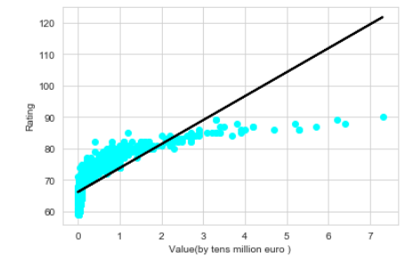
Predict rating by value
Linear Regression
It may seem like our model not shown very good results. That’s just because the predictions seem to be pretty accurate for those players with a value lower than €30M.
Those players represent 99.33% of the total players !
We have 52% accuracy with that method.

Slide 29
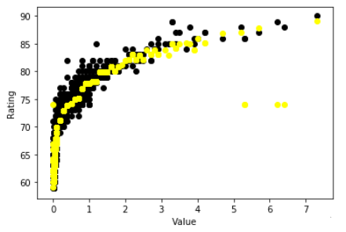
Predict rating by value
Support Vector Regression
We Use the Support Vector Regression
implementation with a radial basis function .
We increase our accuracy.
we got 89% accuracy with that method.

Slide 30

Interpretation

Slide 31
conclusions
We are very satisfied with our final project, we succeed to answer all of our questions that we explored. We learned a lot about this popular game that we so much love. It was really enjoyable to work on a topic that we choose and a topic that we had good preliminary knowledge about it.
We found out many things about players positions in the game such as that CB is the most common position in the game, we also discovered who is the best player in each position and eventually we find out that most of the greatest players in the game are offensive players.
We also detected the players nationality and found out that most of the players in this game come from Europe and South America. We also learned about Israeli players in this game, we found out that there are 22 players from Israel and just 2 of them are in a good level (more than 80).
In this part we learned about plotly and how to create choropleth maps which was really amaizing to work with.
In the physical part we learned that the ages of the players in the game are from 15 to 41. we also have seen how age affect on some parameters.
We found the maximum, minimum and the most common of height and weight of the players.
We surprisingly seen that 182 centimeters is a common height in each group of positions.
We discovered that most of the players are right footed by a large margin.

Slide 32
conclusions
In the last part of the EDA we found out which teams have the most average rating of players. We also have seen which teams have the most “super players” (more than 85 rating).
Eventually we looked on the top 100 players in the game and found out some conclusions such as that there are positions that not belongs to the top 100 players. Other conclusion was that there is even 1 player in the top 100 players than have no club.
In the part of a machine learning we explored the relationship between player’s value to the player’s rating. Eventfully we got a very good results with high accuracy.

